Slide 1
AB / Optimisation
PLP tidy up - Mobile grid - Bigger imagery
Go live 8/10/24

Slide 2
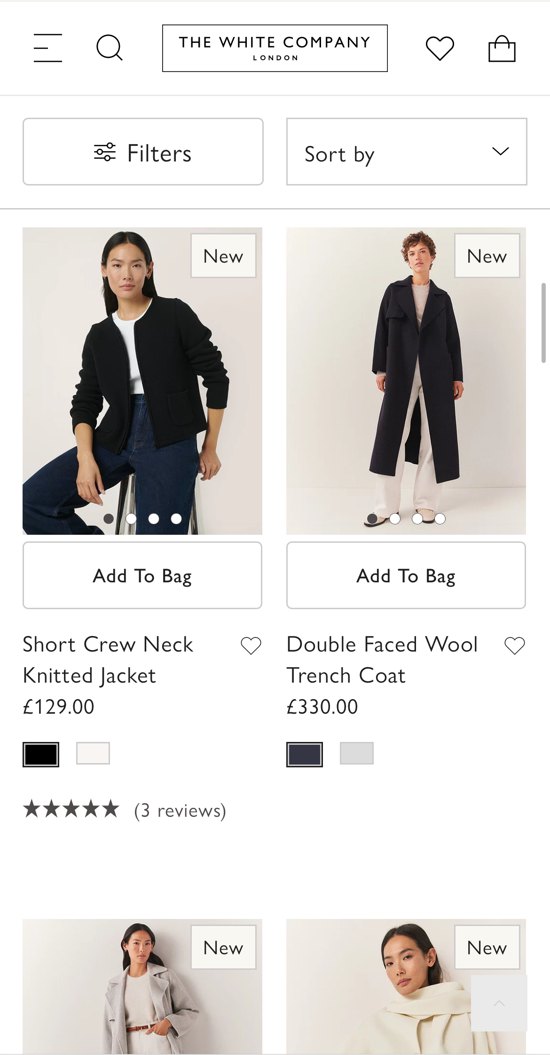
Insight / Opportunity
Hypothesis
Visuals
Specifications
Results
Analysis
Current PLP
Context | The business has the desire to visually tidy up the PLP (especially Mobile). A series of AB tests will focus on testing reduced versions with/without certain features. This is test #1 – focusing on making product imagery bigger.
Execution | Reduce padding in/around the product card to increase the product image size by +9% (and therefore putting more focus on the imagery)
Goal | 1) Make product images visually stand out more 2) Understand the impact of doing so i.e. increase click-through and conversion – as these changes will be rolled out/re-tested across Desktop & App upon test completion.

Slide 3
Insight / Opportunity
Hypothesis
Visuals
Specifications
Results
Analysis
Hypothesis
IF | we make product imagery bigger via reduced padding in/around the product card
THEN | this will drive Conversion
BECAUSE | customers will have greater attention towards the imagery whilst also gaining better product perception
Measurement
Primary KPI | Click through from PLP
Secondary KPI | Conversion
Expected running length | 2-3 weeks
Lever framework (see appendix)
Master lever | Cost | Trust | Usability | Comprehension | Motivation
Lever | Attention. Ways to actively engage users with a particular element

Slide 4
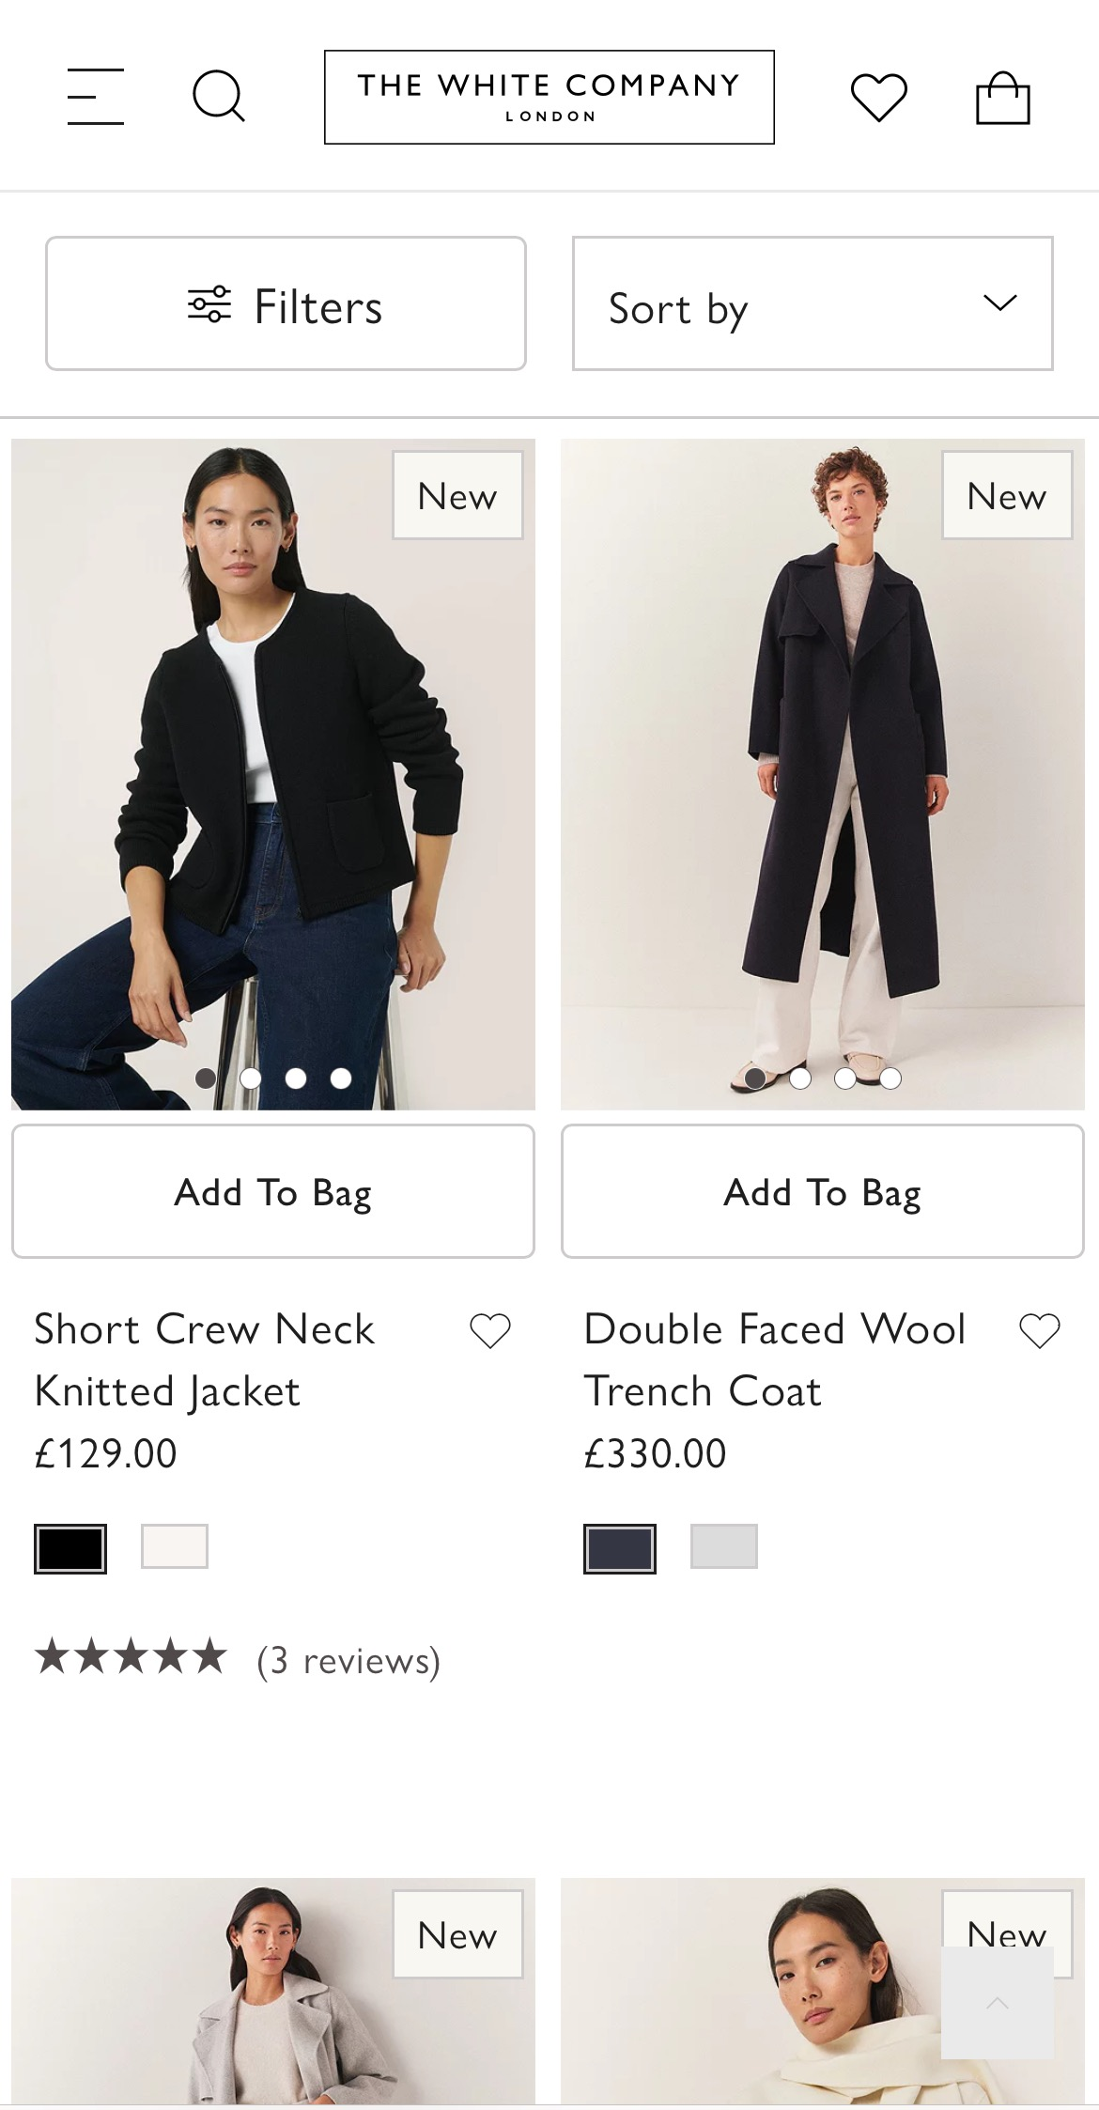
Insight / Opportunity
Hypothesis
Visuals
Specifications
Results
Analysis
Control (A)
Variant B
Padding greatly reduced around the imagery & in-between the imagery

Slide 5
Insight / Opportunity
Hypothesis
Visuals
Specifications
Results
Analysis
Placement
Site | UK
Pages | PLP and SRP only
Exclusions | n/a
Device | Mobile only
Audience | All
Setup
Test type | AB
Traffic allocation | 100%
Traffic distribution | 50/50

Slide 6
Insight / Opportunity
Hypothesis
Visuals
Specifications
Results
Analysis
To follow

Slide 7
Insight / Opportunity
Hypothesis
Visuals
Specifications
Results
Analysis
To follow

Slide 8
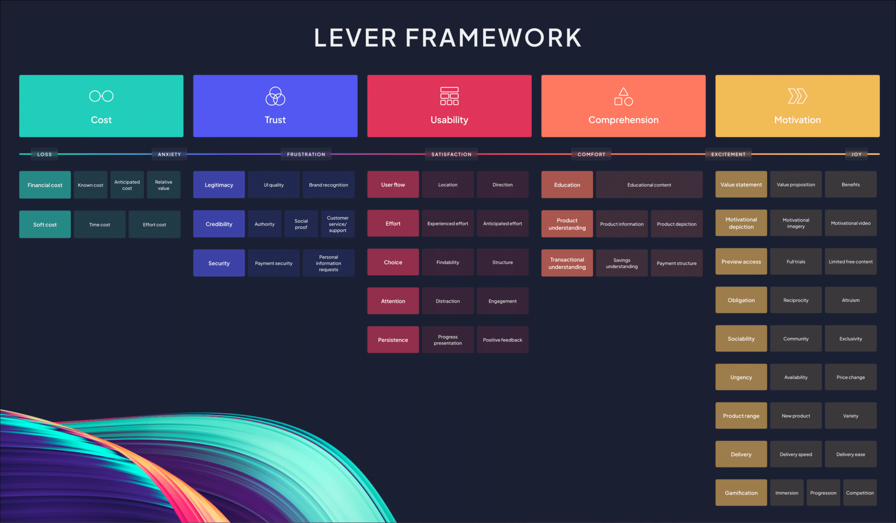
Appendix: Lever framework

